Slide 1
ORANGE MUSIC PLAYER
BY:
Eze-odikwa tochukwu jed

Slide 2
LIBRARIES
ROOM
COROUTINE SUPPORT FOR ROOM
VIEWMODEL AND LIFECYCLE EXTENSIONS
COROUTINE
RECYCLER VIEW
MEDIASTORE
MEDIAPLAYER
GESTUREDETECTOR

Slide 3
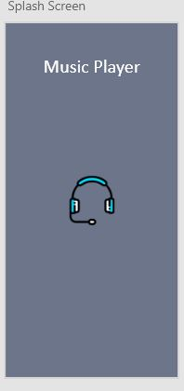
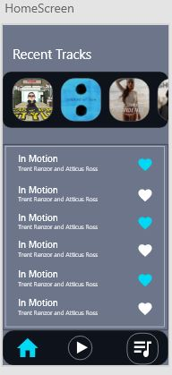
DESIGNS

Slide 4
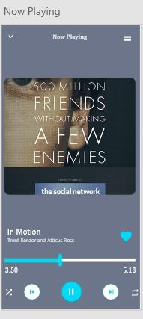
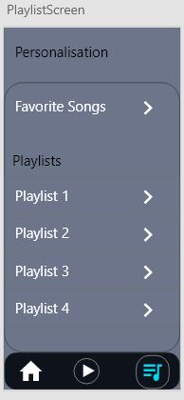

Slide 5
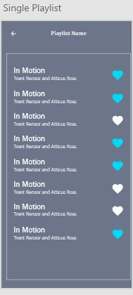

Slide 6
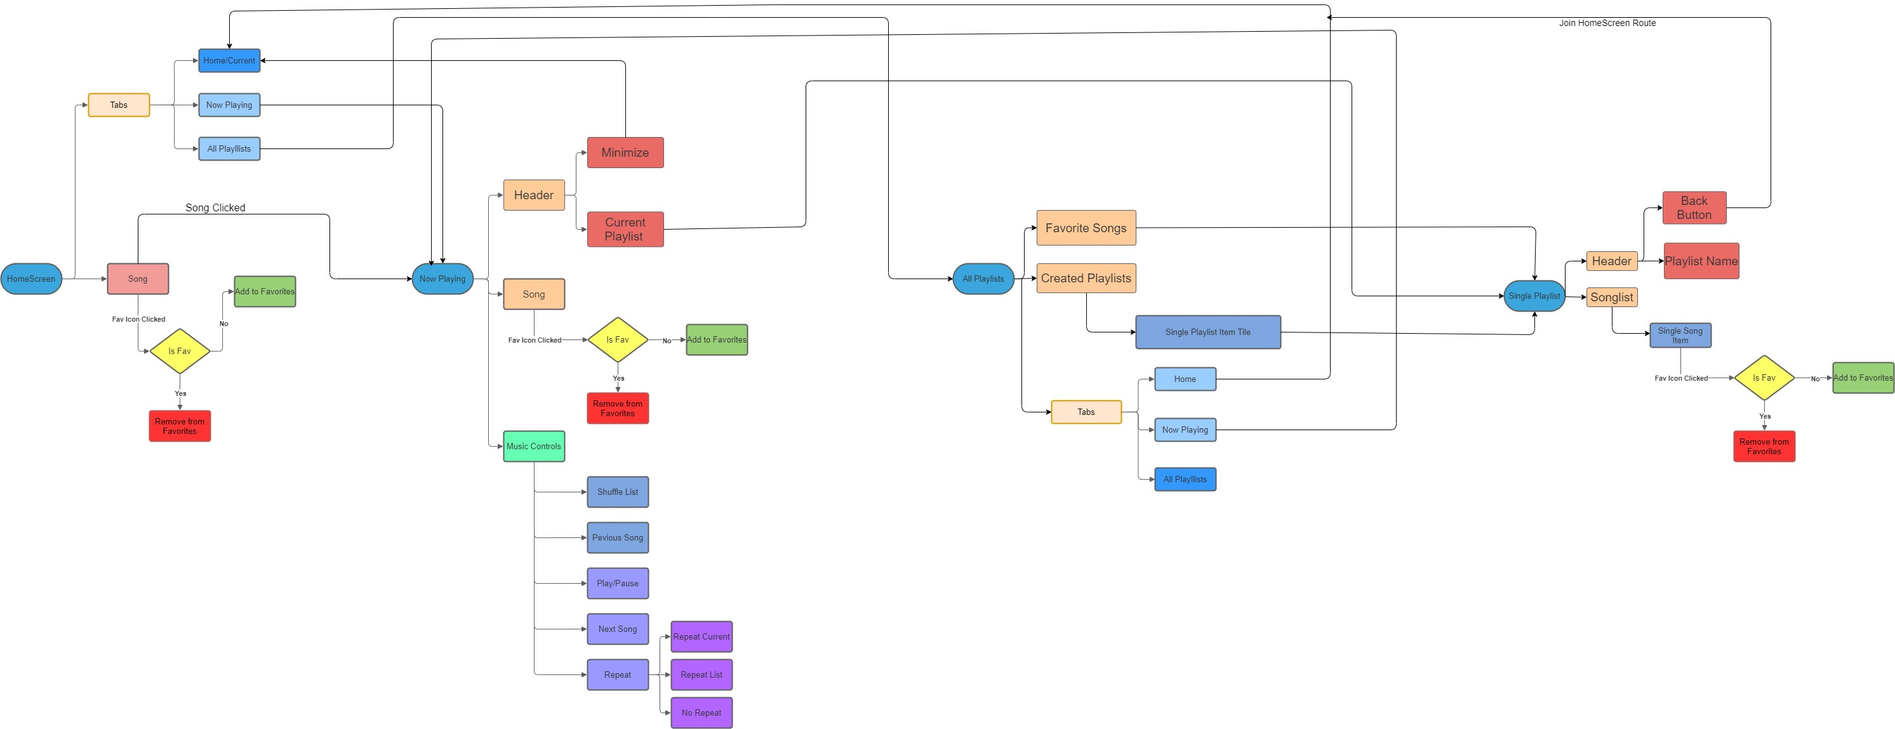
APP FLOW

Slide 7

LEVEL 0 DFD

Slide 8
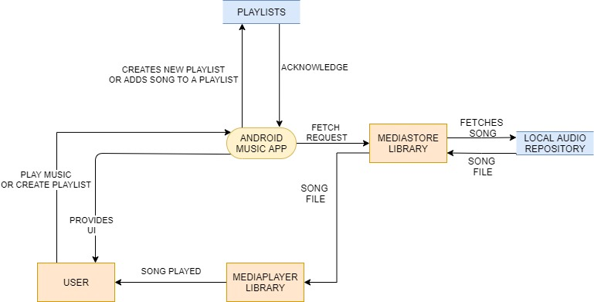
LEVEL 1 DFD

Slide 9
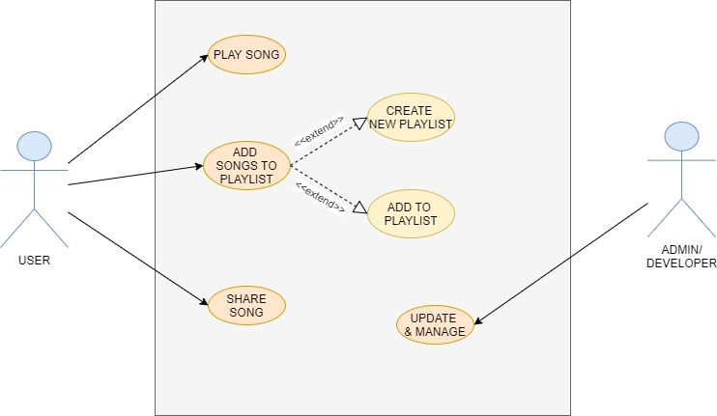
USE CASE DIAGRAM

Slide 10
COLOR THEME
#00d9f6 blue (Used in Icons )
#0e121b black (App theme - App bar,etc)
#6c7589 grey (Background of any activity)
#ffffff white (Used in all texts and symbols)

Slide 11
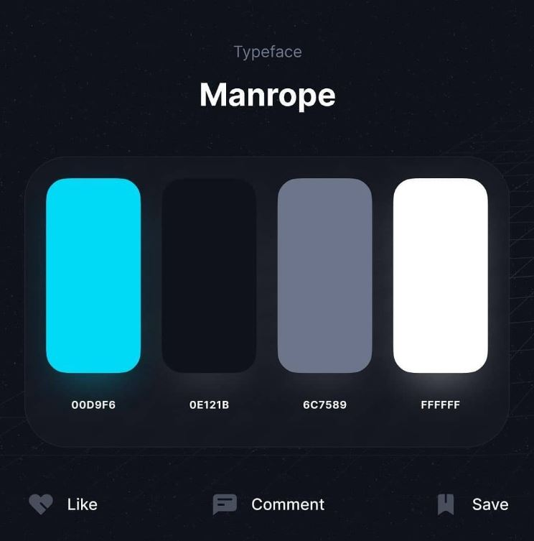

Slide 12
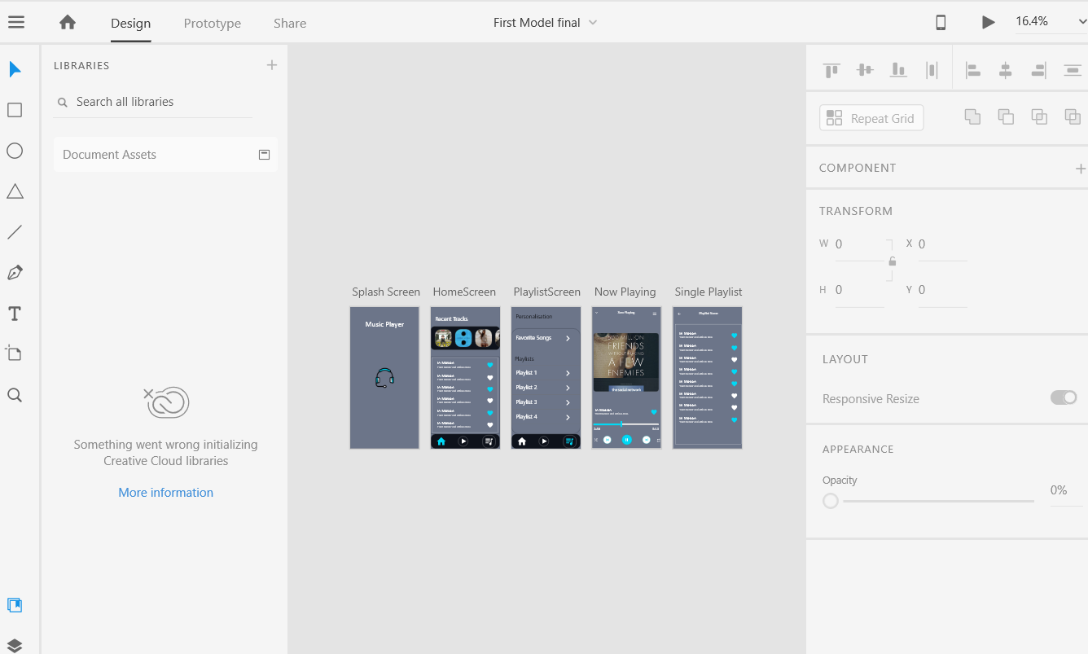
ADOBE XD

Slide 13
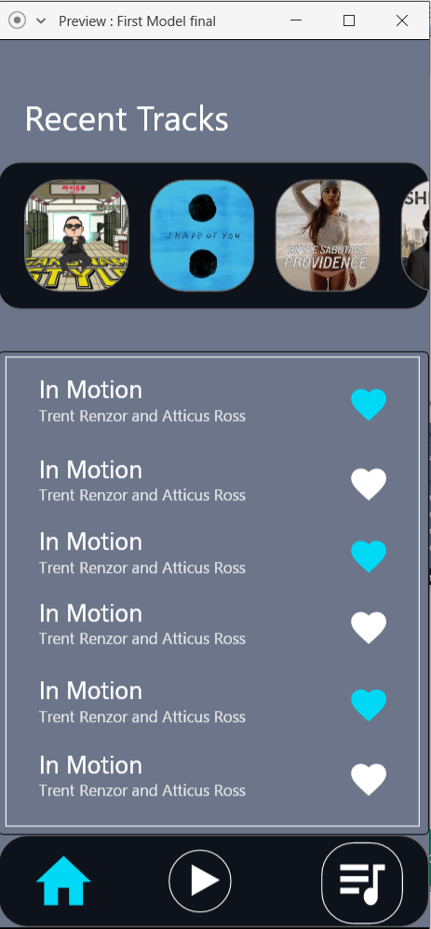
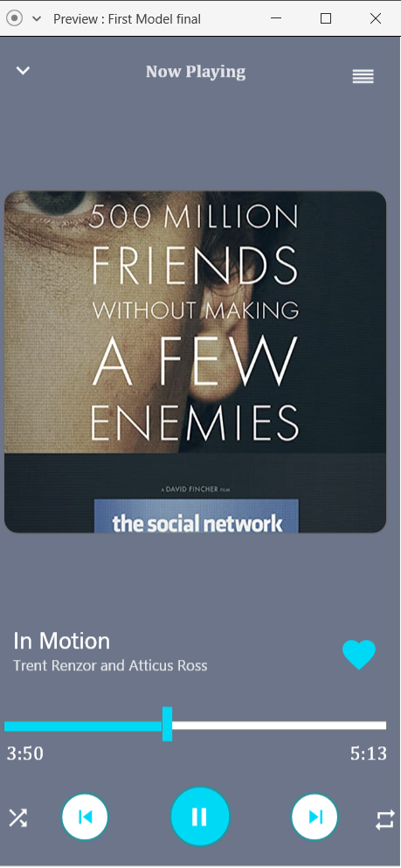
PREVIEW

Slide 14
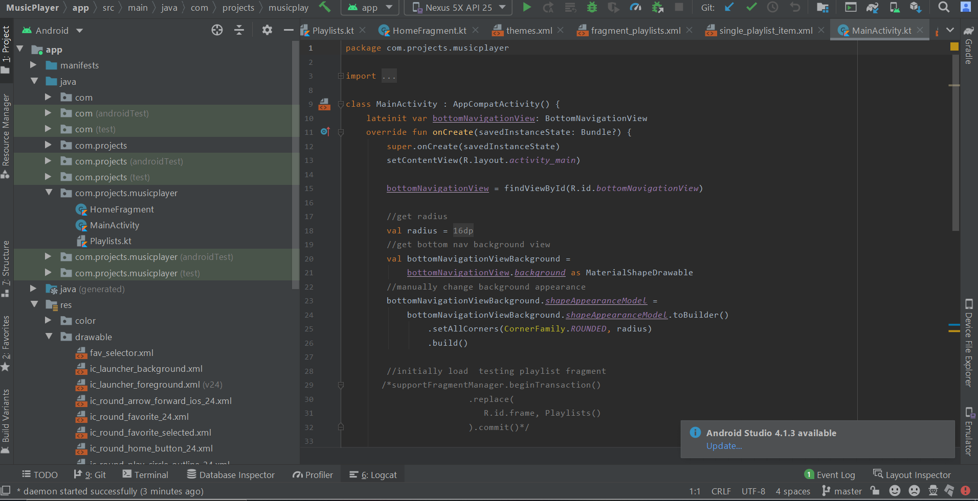
ANDROID STUDIO

Slide 15
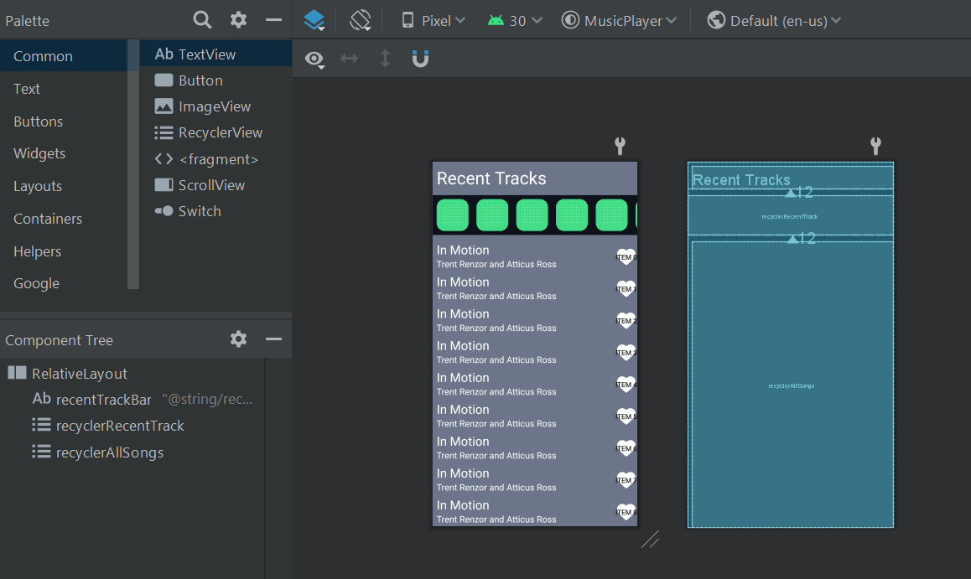
DESIGN IMPLMENTATION

Slide 16
